Slide 1

Principles of Information Security,
Fifth Edition
Chapter 7
Security Technology: Intrusion
Detection and Prevention Systems,
and Other Security Tools
Do not wait; the time will never be just right. Start where you stand and work with whatever tools you may have at your command, and better tools will be found as you go along.
NAPOLEON HILL (1883–1970) FOUNDER OF THE SCIENCE of SUCCESS

Slide 2
Learning Objectives
Upon completion of this material, you should be able to:
  Identify and describe the categories and models of intrusion detection and prevention systems
  Describe the detection approaches employed by modern intrusion detection and prevention systems
  Define and describe honeypots, honeynets, and padded cell systems
  List and define the major categories of scanning and analysis tools, and describe the specific tools used within each category
Principles of Information Security, Fifth Edition
Notes:
Learning Objectives
Upon completion of this material, you should be able to:
Identify and describe the categories and models of intrusion detection and prevention systems
Describe the detection approaches employed by modern intrusion detection and prevention systems
Define and describe honeypots, honeynets, and padded cell systems
List and define the major categories of scanning and analysis tools, and describe the specific tools used within each category

Slide 3
Introduction
Protection of organizations assets relies as much on managerial controls as on technical safeguards.
Properly implemented technical solutions guided by policy are essential to an information security program.
Advanced technologies can be used to enhance the security of information assets.
Principles of Information Security, Fifth Edition
Notes:
Introduction
Protection of organizations assets relies as much on managerial controls as on technical safeguards
Properly implemented technical solutions guided by policy are essential to an information security program
Advanced technologies can be used to enhance the security of information assets

Slide 4
Intrusion Detection and Prevention Systems
An intrusion occurs when an attacker attempts to gain entry into or disrupt the normal operations of an organization’s information systems.
Intrusion prevention consists of activities that deter an intrusion.
Intrusion detection consists of procedures and systems that identify system intrusions.
Intrusion reaction encompasses actions an organization undertakes when intrusion event is detected.
Principles of Information Security, Fifth Edition
Notes:
Intrusion Detection and Prevention Systems
An intrusion occurs when an attacker attempts to gain entry into or disrupt the normal operations of an organization’s information systems
Intrusion prevention consists of activities that deter an intrusion
Intrusion detection consists of procedures and systems that identify system intrusions
Intrusion reaction encompasses actions an organization undertakes when intrusion event is detected

Slide 5
Intrusion Detection and Prevention Systems (cont’d)
Intrusion correction activities: complete restoration of operations to a normal state and seek to identify source and method of intrusion
Intrusion detection systems detect a violation of its configuration and activate alarm.
Many IDPSs enable administrators to configure systems to notify them directly of trouble via e-mail or pagers.
Systems can also be configured to notify an external security service organization of a “break-in.”
Principles of Information Security, Fifth Edition
Notes:
Intrusion Detection and Prevention Systems (IDPSs)
Intrusion correction activities: complete restoration of operations to a normal state and seek to identify source and method of intrusion
Intrusion detection systems detect a violation of its configuration and activate alarm
Many IDPSs enable administrators to configure systems to notify them directly of trouble via e-mail or pagers
Systems can also be configured to notify an external security service organization of a “break-in”

Slide 6
IDPS Terminology
Alarm clustering and compaction
Alarm filtering
Alert or alarm
Confidence value
Evasion
False attack stimulus
False negative and false positive
Noise
Site policy
Site policy awareness
True attack stimulus
Tuning
Principles of Information Security, Fifth Edition
Notes:
IDPS Terminology
Alarm clustering and compaction
Alarm filtering
Alert or alarm
Confidence value
Evasion
False attack stimulus
False negative and false positive
Noise
Site policy
Site policy awareness
True attack stimulus
Tuning

Slide 7
Why Use an IDPS?
Intrusion detection:
  Primary purpose to identify and report an intrusion
  Can quickly contain attack and prevent/mitigate loss or damage
  Detect and deal with preambles to attacks
Data collection allows the organization to examine what happened after an intrusion and why.
Serves as a deterrent by increasing the fear of detection
Can help management with quality assurance and continuous improvement
Principles of Information Security, Fifth Edition
Notes:
Why Use an IDPS?
Intrusion detection:
Primary purpose to identify and report an intrusion
Can quickly contain attack and prevent/mitigate loss or damage
Detect and deal with preambles to attacks
Data collection allows organization to examine what happened after an intrusion and why
Serves as a deterrent by increasing fear of detection
Can help management with quality assurance and continuous improvement

Slide 8
Types of IDPSs
IDPSs operate as network-based or host-based systems.
Network-based IDPS is focused on protecting network information assets.
  Wireless IDPS: focuses on wireless networks
  Network behavior analysis IDPS: examines traffic flow on a network in an attempt to recognize abnormal patterns
Principles of Information Security, Fifth Edition
Notes:
Types of IDPSs and Detection Methods
IDPSs operate as network-based or host-based systems
Network-based IDPS is focused on protecting network information assets
Wireless IDPS: focuses on wireless networks
Network behavior analysis IDPS: examines traffic flow on a network in an attempt to recognize abnormal patterns

Slide 9
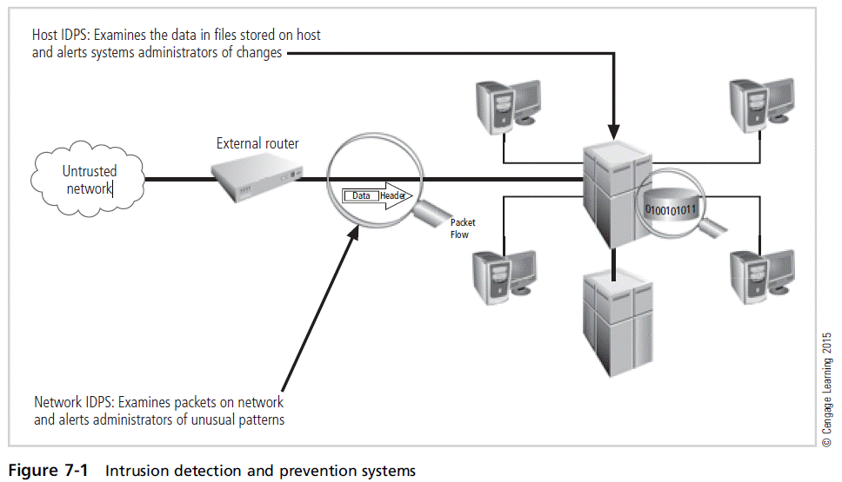
Principles of Information Security, Fifth Edition

Slide 10
Types of IDPSs (cont’d)
Network-based IDPS (NIDPS)
  Resides on a computer or an appliance connected to a segment of an organization’s network; looks for indications of attacks
  When examining packets, a NIDPS looks for attack patterns within network traffic
  Installed at specific place in the network where it can monitor traffic going into and out of a particular network segment
Principles of Information Security, Fifth Edition
Notes:
Network-Based IDPS
Network-based IDPS
Resides on computer or appliance connected to segment of an organization’s network; looks for indications of attacks
When examining packets, a NIDPS looks for attack patterns within network traffic
Installed at specific place in the network where it can monitor traffic going into and out of a particular network segment

Slide 11
Types of IDPSs (cont’d)
Network-based IDPS (NIDPS) (cont’d)
  To determine whether attack has occurred/is under way, compare measured activity to known signatures in knowledge base
  Done by using special implementation of TCP/IP stack:
    In the process of protocol stack verification, NIDPSs look for invalid data packets.
    In the application protocol verification, higher-order protocols are examined for unexpected packet behavior or improper use.
Principles of Information Security, Fifth Edition
Notes:
NIDPS Signature Matching
NIDPS (cont’d.)
To determine whether attack has occurred/is under way, compare measured activity to known signatures in knowledge base
Done by using special implementation of TCP/IP stack:
In process of protocol stack verification, NIDPSs look for invalid data packets
In application protocol verification, higher-order protocols are examined for unexpected packet behavior or improper use

Slide 12
Types of IDPSs (cont’d)
Advantages of NIDPSs
  Good network design and placement of NIDPS can enable an organization to monitor a large network with few devices.
  NIDPSs are usually passive and can be deployed into existing networks with little disruption to normal network operations.
  NIDPSs are not usually susceptible to direct attack and may not be detectable by attackers.
Principles of Information Security, Fifth Edition
Notes:
Advantages of NIDPSs
Good network design and placement of NIDPS can enable organization to monitor large network with few devices
NIDPSs are usually passive and can be deployed into existing networks with little disruption to normal network operations
NIDPSs not usually susceptible to direct attack and may not be detectable by attackers

Slide 13
Types of IDPSs (cont’d)
Disadvantages of NIDPSs
  Can become overwhelmed by network volume and fail to recognize attacks
  Require access to all traffic to be monitored
  Cannot analyze encrypted packets
  Cannot reliably ascertain if attack was successful or not
  Some forms of attack are not easily discerned by NIDPSs, specifically those involving fragmented packets.
Principles of Information Security, Fifth Edition
Notes:
Disadvantages of NIDPSs
A NIDPS can become overwhelmed by network volume and fail to recognize attacks it might otherwise have detected.
NIDPSs require access to all traffic to be monitored.
NIDPSs cannot analyze encrypted packets, making some of the network traffic invisible to the process.
NIDPSs cannot reliably ascertain if an attack was successful or not.
Some forms of attack are not easily discerned by NIDPSs, specifically those involving fragmented packets.

Slide 14
Types of IDPSs (cont’d)
Wireless NIDPS
  Monitors and analyzes wireless network traffic
  Issues associated with it include physical security, sensor range, access point and wireless switch locations, wired network connections, cost, AP and wireless switch locations.
Network behavior analysis systems
  Identify problems related to the flow of traffic
  Types of events commonly detected include denial-of-service (DoS) attacks, scanning, worms, unexpected application services, and policy violations.
  Offer intrusion prevention capabilities that are passive, inline, and both passive and inline
Principles of Information Security, Fifth Edition
Notes:
Wireless NIDPS
Monitors and analyzes wireless network traffic
Issues associated with it include physical security, sensor range, access point and wireless switch locations, wired network connections, cost, AP and wireless switch locations
Network behavior analysis systems
Identify problems related to the flow of traffic
Types of events commonly detected include DoS attacks, scanning, worms, unexpected application services, policy violations
Offers intrusion prevention capabilities that are passive, inline, and both passive and inline

Slide 15
Types of IDPSs (cont’d)
Host-based IDPS (HIDPS)
  Resides on a particular computer or server (host) and monitors activity only on that system
  Benchmarks and monitors the status of key system files and detects when intruder creates, modifies, or deletes files
  Advantage over NIDPS: can access encrypted information traveling over network and make decisions about potential/actual attacks
  Most HIDPSs work on the principle of configuration or change management.
Principles of Information Security, Fifth Edition
Notes:
Host-Based IDPS
Resides on a particular computer or server (host) and monitors activity only on that system
Benchmark and monitor the status of key system files and detect when intruder creates, modifies, or deletes files
Advantage over NIDPS: can access encrypted information traveling over network and make decisions about potential/actual attacks
Most HIDPSs work on the principle of configuration or change management

Slide 16
Types of IDPSs (cont’d)
Advantages of HIDPSs
  Can detect local events on host systems and detect attacks that may elude a network-based IDPS
  Functions on host system, where encrypted traffic will have been decrypted and is available for processing
  Not affected by use of switched network protocols
  Can detect inconsistencies in how applications and systems programs were used by examining records stored in audit logs
Principles of Information Security, Fifth Edition
Notes:
Advantages of HIDPSs
Can detect local events on host systems and detect attacks that may elude a network-based IDPS
Functions on host system, where encrypted traffic will have been decrypted and is available for processing
Not affected by use of switched network protocols
Can detect inconsistencies in how applications and systems programs were used by examining records stored in audit logs

Slide 17
Types of IDPSs (cont’d)
Disadvantages of HIDPSs
  Pose more management issues
  Vulnerable both to direct attacks and attacks against host operating system
  Does not detect multihost scanning, nor scanning of non-host network devices
  Susceptible to some DoS attacks
  Can use large amounts of disk space
  Can inflict a performance overhead on its host systems
Principles of Information Security, Fifth Edition
Notes:
Disadvantages of HIDPS
HIDPSs pose more management issues since they are configured and managed on each monitored host.
A HIDPS is vulnerable both to direct attacks and to attacks against the host operating system.
A HIDPS is not optimized to detect multi-host scanning, nor is it able to detect the scanning of non-host network devices, such as routers or switches.
A HIDPS is susceptible to some denial-of-service attacks.
A HIDPS can use large amounts of disk space to retain the host OS audit logs; to function properly, it may require disk capacity to be added to the system.
A HIDPS can inflict a performance overhead on its host systems, and in some cases may reduce system performance below acceptable levels.

Slide 18
IDPS Detection Methods
Signature-based detection
  Examines network traffic in search of patterns that match known signatures
  Widely used because many attacks have clear and distinct signatures
  Problem with this approach is that new attack patterns must continually be added to IDPS’s database of signatures.
    Slow, methodical attack involving multiple events might escape detection.
Principles of Information Security, Fifth Edition
Notes:
Signature-based detection
Examines network traffic in search of patterns that match known signatures
Widely used because many attacks have clear and distinct signatures
Problem with this approach is that new attack patterns must continually be added to IDPS’s database of signatures
Slow, methodical attack involving multiple events might escape detection

Slide 19
IDPS Detection Methods (cont’d)
Anomaly-based detection
  Anomaly-based detection (or behavior-based detection) collects statistical summaries by observing traffic known to be normal.
  When measured activity is outside baseline parameters or clipping level, IDPS sends alert to administrator.
  IDPS can detect new types of attacks.
  Requires much more overhead and processing capacity than signature-based detection
  May generate many false positives
Principles of Information Security, Fifth Edition
Notes:
Anomaly-based detection
Anomaly-based detection (or behavior-based detection) collects statistical summaries by observing traffic known to be normal
When measured activity is outside baseline parameters or clipping level, IDPS sends alert to administrator
IDPS can detect new types of attacks
Requires much more overhead and processing capacity than signature-based
May generate many false positives

Slide 20
IDPS Detection Methods (cont’d)
Stateful protocol analysis
  SPA: process of comparing known normal/benign protocol profiles against observed traffic
  Stores and uses relevant data detected in a session to identify intrusions involving multiple requests /responses; allows IDPS to better detect specialized, multisession attacks (also called deep packet inspection)
  Drawbacks: analytical complexity; heavy processing overhead; may fail to detect intrusion unless protocol violates fundamental behavior; may interfere with normal operations of protocol
Principles of Information Security, Fifth Edition
Notes:
Stateful protocol analysis
SPA: process of comparing known normal/benign protocol profiles against observed traffic
Stores and uses relevant data detected in a session to identify intrusions involving multiple requests/responses; allows IDPS to better detect specialized, multisession attacks (also called deep packet inspection)
Drawbacks: analytical complexity; heavy processing overhead; may fail to detect intrusion unless protocol violates fundamental behavior; may interfere with normal operations of protocol

Slide 21
IDPS Detection Methods (cont’d)
Log file monitors
  Log file monitor (LFM) similar to NIDPS
  Reviews log files generated by servers, network devices, and even other IDPSs for patterns and signatures
  Patterns that signify attack may be much easier to identify when entire network and its systems are viewed as a whole
  Requires considerable resources since it involves the collection, movement, storage, and analysis of large quantities of log data
Principles of Information Security, Fifth Edition
Notes:
Log File Monitors
Log file monitor (LFM) similar to NIDPS
Reviews log files generated by servers, network devices, and even other IDPSs for patterns and signatures
Patterns that signify attack may be much easier to identify when entire network and its systems are viewed as a whole
Requires considerable resources since it involves the collection, movement, storage, and analysis of large quantities of log data

Slide 22
IDPS Response Behavior
IDPS response to external stimulation depends on the configuration and function; many response options are available.
IDPS responses can be classified as active or passive.
  Active response: collecting additional information about the intrusion, modifying the network environment, taking action against the intrusion
  Passive response: setting off alarms or notifications, collecting passive data through SNMP traps
Many IDPSs can generate routine reports and other detailed documents.
Failsafe features protect IDPS from being circumvented.
Principles of Information Security, Fifth Edition
Notes:
IDPS Response Behavior
IDPS response to external stimulation depends on configuration and function; many response options available
IDPS responses can be classified as active or passive
Active response: collecting additional information about the intrusion, modifying the network environment, taking action against the intrusion
Passive response: setting off alarms or notifications, collecting passive data through SNMP traps
Many IDPSs can generate routine reports and other detailed documents
Failsafe features protect IDPS from being circumvented

Slide 23
Selecting IDPS Approaches and Products
Technical and policy considerations
  What is your systems environment?
  What are your security goals and objectives?
  What is your existing security policy?
Organizational requirements and constraints
  What requirements are levied from outside the organization?
  What are your organization’s resource constraints?
Principles of Information Security, Fifth Edition
Notes:
Selecting IDPS Approaches and Products
Technical and policy considerations
What is your systems environment?
What are your security goals and objectives?
What is your existing security policy?
Organizational requirements and constraints
What requirements are levied from outside the organization?
What are your organization’s resource constraints

Slide 24
Selecting IDPS Approaches and Products (cont’d)
IDPSs product features and quality
  Is the product sufficiently scalable for your environment?
  How has the product been tested?
  What user level of expertise is targeted by the product?
  Is the product designed to evolve as the organization grows?
  What are the support provisions for the product?
Principles of Information Security, Fifth Edition
Notes:
IDPSs Product Features & Quality
Is the product sufficiently scalable for your environment?
How has the product been tested?
What user level of expertise is targeted by the product?
Is the product designed to evolve as the organization grows?
What are the support provisions for the product?

Slide 25
Strengths and Limitations of IDPSs
IDPSs perform the following functions well:
  Monitoring and analysis of system events and user behaviors
  Testing security states of system configurations
  Baselining security state of system and tracking changes
  Recognizing patterns of system events corresponding to known attacks
  Recognizing activity patterns that vary from normal activity
Principles of Information Security, Fifth Edition
Notes:
Strengths/Limitations of IDPSs
IDPSs perform the following functions well:
Monitoring and analysis of system events and user behaviors
Testing security states of system configurations
Baselining security state of system and tracking changes
Recognizing patterns of system events corresponding to known attacks
Recognizing activity patterns that vary from normal activity

Slide 26
Strengths and Limitations of IDPSs (cont’d)
IDPSs perform the following functions well: (cont’d)
  Managing OS audit and logging mechanisms and data they generate
  Alerting appropriate staff when attacks are detected
  Measuring enforcement of security policies encoded in analysis engine
  Providing default information on security policies
  Allowing non-security experts to perform important security monitoring functions
Principles of Information Security, Fifth Edition
Notes:
Strengths/Limitations of IDPSs
IDPSs perform the following functions well: (cont’d.)
Managing OS audit and logging mechanisms and data they generate
Alerting appropriate staff when attacks are detected
Measuring enforcement of security policies encoded in analysis engine
Providing default information security policies
Allowing non-security experts to perform important security monitoring functions

Slide 27
Strengths and Limitations of IDPSs (cont’d)
IDPSs cannot perform the following functions:
  Compensating for weak/missing security mechanisms in protection infrastructure
  Instantaneously detecting, reporting, responding to attack when there is heavy network or processing load
  Detecting new attacks or variants of existing attacks
  Effectively responding to attacks by sophisticated attackers
  Automatically investigating attacks without human intervention
Principles of Information Security, Fifth Edition
Notes:
Strengths/Limitations of IDPSs
IDPSs cannot perform the following functions:
Compensating for weak/missing security mechanisms in protection infrastructure
Instantaneously detecting, reporting, responding to attack when there is heavy network or processing load
Detecting new attacks or variants of existing attacks
Effectively responding to attacks by sophisticated attackers
Automatically investigating attacks without human intervention

Slide 28
Strengths and Limitations of IDPSs (cont’d)
IDPSs cannot perform the following functions (cont’d):
  Resisting attacks intended to defeat or circumvent them
  Compensating for problems with fidelity of information sources
  Dealing effectively with switched networks
Principles of Information Security, Fifth Edition
Notes:
Strengths/Limitations of IDPSs
IDPSs cannot perform the following functions (cont’d.):
Resisting attacks intended to defeat or circumvent them
Compensating for problems with fidelity of information sources
Dealing effectively with switched networks

Slide 29
Deployment and Implementation of an IDPS
An IDPS can be implemented via one of three basic control strategies:
  Centralized: All IDPS control functions are implemented and managed in a central location.
  Fully distributed: All control functions are applied at the physical location of each IDPS component.
  Partially distributed: Combines the two; while individual agents can still analyze and respond to local threats, they report to a hierarchical central facility to enable organization to detect widespread attacks.
Principles of Information Security, Fifth Edition
Notes:
IDPS Control Strategies
An IDPS can be implemented via one of three basic control strategies.
A control strategy determines how an organization exerts influence and maintains the configuration of an IDPS.
The three commonly utilized control strategies are:
Centralized IDPS control strategy—All IDPS control functions are implemented and managed in a central location.
Fully distributed IDPS control strategy—Control functions are applied at the physical location of each IDPS component.
Partially distributed IDPS control strategy—Combines the two: While the individual agents can still analyze and respond to local threats, they report to a hierarchical central facility to enable the organization to detect widespread attacks.

Slide 30
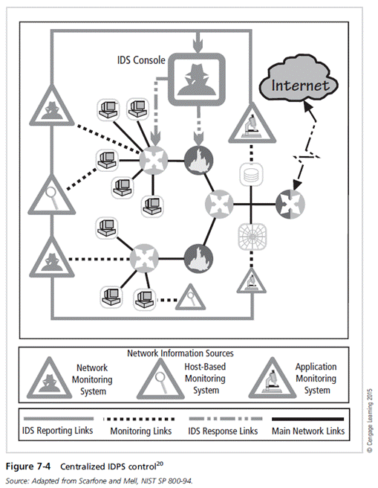
Principles of Information Security, Fifth Edition

Slide 31
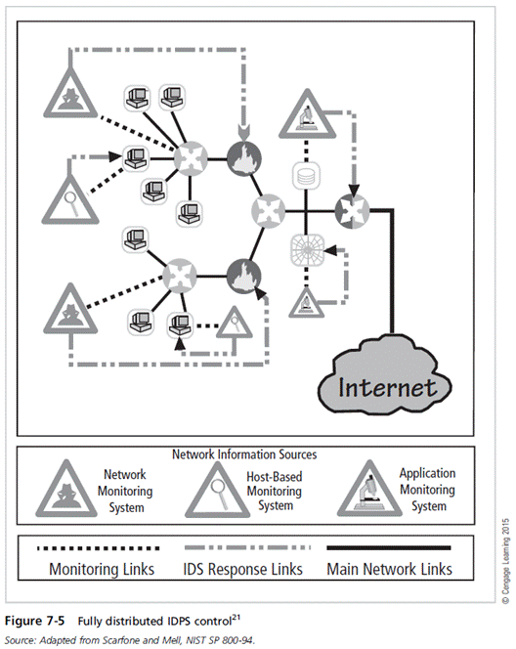
Principles of Information Security, Fifth Edition

Slide 32
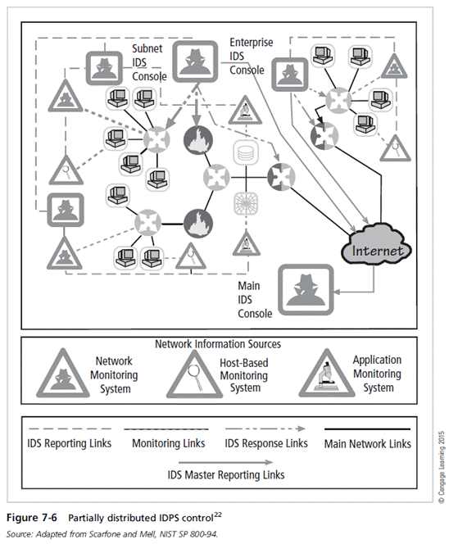
Principles of Information Security, Fifth Edition

Slide 33
Deployment and Implementation of an IDPS (cont’d)
IDPS deployment
  Great care must be taken when deciding where to locate components.
  Planners must select deployment strategy that is based on careful analysis of organization’s information security requirements and causes minimal impact.
  NIDPS and HIDPS can be used in tandem to cover individual systems that connect to an organization’s network and networks themselves.
Principles of Information Security, Fifth Edition
Notes:
IDPS Deployment
Great care must be taken when deciding where to locate components
Planners must select deployment strategy that is based on careful analysis of organization’s information security requirements and causes minimal impact
NIDPS and HIDPS can be used in tandem to cover individual systems that connect to an organization’s networks and networks themselves

Slide 34
Deployment and Implementation of an IDPS (cont’d)
Deploying network-based IDPSs
  NIST recommends four locations for NIDPS sensors
    Location 1: Behind each external firewall, in the network DMZ
    Location 2: Outside an external firewall
    Location 3: On major network backbones
    Location 4: On critical subnets
Principles of Information Security, Fifth Edition
Notes:
Deploying Network-Based IDPSs
NIST recommends four locations for NIDPS sensors
Location 1: Behind each external firewall, in the network DMZ
Location 2: Outside an external firewall
Location 3: On major network backbones
Location 4: On critical subnets

Slide 35
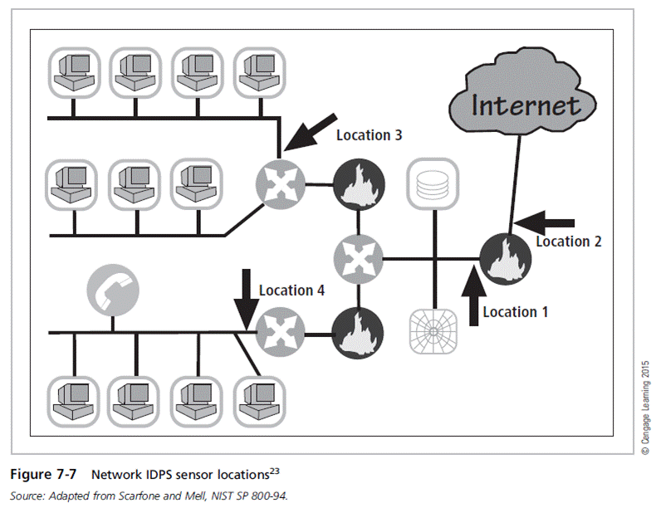
Principles of Information Security, Fifth Edition

Slide 36
Deployment and Implementation of an IDPS (cont’d)
Deploying host-based IDPSs
  Proper implementation of HIDPSs can be a painstaking and time-consuming task.
  Deployment begins with implementing most critical systems first.
  Installation continues until either all systems are installed or the organization reaches planned degree of coverage it will accept.
Principles of Information Security, Fifth Edition
Notes:
Deploying Host-Based IDPSs
Proper implementation of HIDPSs can be a painstaking and time-consuming task
Deployment begins with implementing most critical systems first
Installation continues until either all systems are installed or the organization reaches planned degree of coverage it will accept

Slide 37
Measuring the Effectiveness of IDPSs
IDPSs are evaluated using four dominant metrics: thresholds, blacklists and whitelists, alert settings, and code viewing and editing.
Evaluation of IDPS might read: At 100 Mb/s, IDPS was able to detect 97 percent of directed attacks.
Because developing this collection can be tedious, most IDPS vendors provide testing mechanisms to verify systems are performing as expected.
Principles of Information Security, Fifth Edition
Notes:
Measuring IDPSs’ Effectiveness
IDPSs are evaluated using four dominant metrics: thresholds, blacklists and whitelists, alert settings, and code viewing and editing
Evaluation of IDPS might read: at 100 Mb/s, IDPS was able to detect 97% of directed attacks
Because developing this collection can be tedious, most IDPS vendors provide testing mechanisms to verify systems are performing as expected

Slide 38
Measuring the Effectiveness of IDPSs (cont’d)
Some of these testing processes will enable the administrator to:
  Record and retransmit packets from real virus or worm scan
  Record and retransmit packets from a real virus or worm scan with incomplete TCP/IP session connections (missing SYN packets)
  Conduct a real virus or worm scan against a hardened or sacrificial system
Testing process should be as realistic as possible.
Principles of Information Security, Fifth Edition
Notes:
Measuring IDPSs’ Effectiveness (continued)
Some of these testing processes will enable the administrator to:
Record and retransmit packets from real virus or worm scan
Record and retransmit packets from a real virus or worm scan with incomplete TCP/IP session connections (missing SYN packets)
Conduct a real virus or worm scan against a hardened or sacrificial system

Slide 39
Honeypots, Honeynets, and Padded Cell Systems
Honeypots: decoy systems designed to lure potential attackers away from critical systems
Honeynets: several honeypots connected together on a network segment
Honeypots are designed to:
  Divert attacker from accessing critical systems
  Collect information about attacker’s activity
  Encourage attacker to stay on a system long enough for administrators to document the event and perhaps respond
Principles of Information Security, Fifth Edition
Notes:
Honeypots, Honeynets, and Padded Cell Systems
Honeypots: decoy systems designed to lure potential attackers away from critical systems
Honeynets: several honeypots connected together on a network segment
Honeypots designed to:
Divert attacker from accessing critical systems
Collect information about attacker’s activity
Encourage attacker to stay on system long enough for administrators to document event and perhaps respond

Slide 40
Honeypots, Honeynets, and Padded Cell Systems (cont’d)
Padded cell system: protected honeypot that cannot be easily compromised
In addition to attracting attackers with tempting data, a padded cell operates in tandem with a traditional IDPS.
When the IDPS detects attackers, padded cell system seamlessly transfers them to a special simulated environment where they can cause no harm—hence the name padded cell.
Principles of Information Security, Fifth Edition
Notes:
Padded Cell Systems
Padded cell system: protected honeypot that cannot be easily compromised
In addition to attracting attackers with tempting data, a padded cell operates in tandem with a traditional IDPS
When the IDPS detects attackers, padded cell system seamlessly transfers them to a special simulated environment where they can cause no harm—hence the name padded cell

Slide 41
Honeypots, Honeynets, and Padded Cell Systems (cont’d)
Advantages
  Attackers can be diverted to targets they cannot damage.
  Administrators have time to decide how to respond to an attacker.
  Attackers’ actions can be easily and more extensively monitored, and records can be used to refine threat models and improve system protections.
  Honeypots may be effective at catching insiders who are snooping around a network.
Principles of Information Security, Fifth Edition
Notes:
Honey Pots, Honey Nets, and Padded Cell Systems
Advantages
Attackers can be diverted to targets they cannot damage
Administrators have time to decide how to respond to attacker
Attackers’ actions can be easily and more extensively monitored, and records can be used to refine threat models and improve system protections
Honeypots may be effective at catching insiders who are snooping around a network

Slide 42
Honeypots, Honeynets, and Padded Cell Systems (cont’d)
Disadvantages
  Legal implications of using such devices are not well understood.
  Honeypots and padded cells have not yet been shown to be generally useful security technologies.
  An expert attacker, once diverted into a decoy system, may become angry and launch a more aggressive attack against an organization’s systems.
  Administrators and security managers need a high level of expertise to use these systems.
Principles of Information Security, Fifth Edition
Notes:
Honey Pots, Honey Nets, and Padded Cell Systems (continued)
Disadvantages
Legal implications of using such devices are not well understood
Honeypots and padded cells have not yet been shown to be generally useful security technologies
An expert attacker, once diverted into a decoy system, may become angry and launch a more aggressive attack against an organization’s systems
Administrators and security managers need a high level of expertise to use these systems

Slide 43
Trap-and-Trace Systems
Use a combination of techniques to detect an intrusion and trace it back to its source
Trap usually consists of a honeypot or a padded cell and alarm.
Legal drawbacks to trap and trace
  Enticement: act of attracting attention to system by placing tantalizing information in key locations
  Entrapment: act of luring an individual into committing a crime to get a conviction
  Enticement is legal and ethical, entrapment is not.
Principles of Information Security, Fifth Edition
Notes:
Trap-and-Trace Systems
Use combination of techniques to detect an intrusion and trace it back to its source
Trap usually consists of honeypot or padded cell and alarm
Legal drawbacks to trap and trace
Enticement: act of attracting attention to system by placing tantalizing information in key locations
Entrapment: act of luring an individual into committing a crime to get a conviction
Enticement is legal and ethical, entrapment is not

Slide 44
Active Intrusion Prevention
Some organizations implement active countermeasures.
One tool (LaBrea) takes up unused IP address space to pretend to be a computer and allow attackers to complete a connection request, but then holds connection open.
Principles of Information Security, Fifth Edition
Notes:
Active Intrusion Prevention
Some organizations implement active countermeasures
One tool (LaBrea) takes up unused IP address space to pretend to be a computer and allow attackers to complete a connection request, but then holds connection open

Slide 45
Scanning and Analysis Tools
Scanning tools typically are used to collect information that an attacker needs to launch a successful attack.
Attack protocol is a logical sequence of steps or processes used by an attacker to launch an attack against a target system or network.
Footprinting: process of collecting publicly available information about a potential target
Principles of Information Security, Fifth Edition
Notes:
Scanning and Analysis Tools
Scanning tools typically used to collect information that attacker needs to launch successful attack
Attack protocol is a logical sequence of steps or processes used by an attacker to launch attack against a target system or network
Footprinting: process of collecting publicly available information about a potential target

Slide 46
Scanning and Analysis Tools (cont’d)
Fingerprinting: systematic survey of target organization’s Internet addresses collected during the footprinting phase to identify network services offered by hosts in that range
Fingerprinting reveals useful information about the internal structure and nature of the target system or network to be attacked.
These tools are valuable to the network defender since they can quickly pinpoint the parts of the systems or network that need a prompt repair to close vulnerabilities.
Principles of Information Security, Fifth Edition
Notes:
Scanning and Analysis Tools (continued)
Fingerprinting: systematic survey of target organization’s Internet addresses collected during the footprinting phase to identify network services offered by hosts in that range
Fingerprinting reveals useful information about internal structure and nature of target system or network to be attacked
These tools are valuable to network defender since they can quickly pinpoint the parts of the systems or network that need a prompt repair to close vulnerabilities

Slide 47
Port Scanners
Tools used by both attackers and defenders to identify/fingerprint computers active on a network and other useful information
Can either perform generic scans or those for specific types of computers, protocols, or resources
The more specific the scanner is, the more useful its information is to attackers and defenders.
Principles of Information Security, Fifth Edition
Notes:
Port Scanners
Tools used by both attackers and defenders to identify/fingerprint computers active on a network and other useful information
Can either perform generic scans or those for specific types of computers, protocols, or resources
The more specific the scanner is, the more useful its information is to attackers and defenders

Slide 48
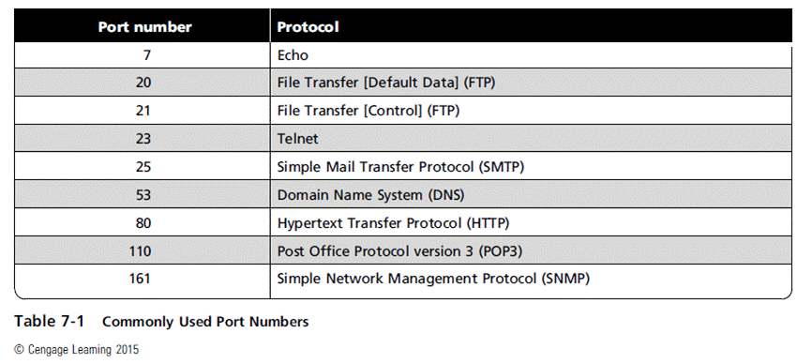
Principles of Information Security, Fifth Edition

Slide 49
Firewall Analysis Tools
Several tools automate remote discovery of firewall rules and assist the administrator/attacker in analyzing them.
Administrators who feel wary of using the same tools that attackers use should remember:
  User intent dictates how gathered information will be used.
  To defend a computer or network well, administrators must understand ways it can be attacked.
A tool that can help close an open or poorly configured firewall will help the network defender minimize risk from attack.
Principles of Information Security, Fifth Edition
Notes:
Firewall Analysis Tools
Several tools automate remote discovery of firewall rules and assist the administrator/attacker in analyzing them
Administrators who feel wary of using the same tools that attackers use should remember:
User intent dictates how gathered information will be used
To defend a computer or network well, administrators must understand ways it can be attacked
A tool that can help close an open or poorly configured firewall will help network defender minimize risk from attack

Slide 50
Operating System Detection Tools
Ability to detect a target computer’s operating system (OS) is very valuable to an attacker.
  Once OS is known, the attacker can easily determine the vulnerabilities to which it is susceptible.
Many tools use networking protocols to determine a remote computer’s OS.
Principles of Information Security, Fifth Edition
Notes:
Operating System Detection Tools
Ability to detect a target computer’s operating system (OS) is very valuable to an attacker
Once OS known, attacker can easily determine vulnerabilities to which it is susceptible
Many tools use networking protocols to determine a remote computer’s OS

Slide 51
Vulnerability Scanners
Active vulnerability scanners examine networks for highly detailed information and initiate traffic to determine security holes.
Passive vulnerability scanners listen in on network and identify the vulnerable versions of both server and client software.
Passive vulnerability scanners have the ability to find client-side vulnerabilities typically not found in active scanners.
Principles of Information Security, Fifth Edition
Notes:
Vulnerability Scanners
Active vulnerability scanners examine networks for highly detailed information; initiate traffic to determine security holes
Passive vulnerability scanners listen in on network and identify vulnerable versions of both server and client software
Passive vulnerability scanners have ability to find client-side vulnerabilities typically not found in active scanners

Slide 52
Packet Sniffers
Network tool that captures copies of packets from network and analyzes them
Can provide network administrator with valuable information for diagnosing and resolving networking issues
In the wrong hands, a sniffer can be used to
eavesdrop on network traffic.
To use packet sniffers legally, an administrator must be on a network that the organization owns, be under direct authorization of owners of the network, and have knowledge and consent of the content’s creators.
Principles of Information Security, Fifth Edition
Notes:
Packet Sniffers
Network tool that captures copies of packets from network and analyzes them
Can provide network administrator with valuable information for diagnosing and resolving networking issues
In the wrong hands, a sniffer can be used to eavesdrop on network traffic
To use packet sniffer legally, administrator must be on network that organization owns, be under direct authorization of owners of network, and have knowledge and consent of the content’s creators

Slide 53
Wireless Security Tools
An organization that spends its time securing a wired network while ignoring wireless networks is exposing itself to a security breach.
Security professionals must assess the risk of wireless networks.
A wireless security toolkit should include the ability to sniff wireless traffic, scan wireless hosts, and assess the level of privacy or confidentiality afforded on the wireless network.
Principles of Information Security, Fifth Edition
Notes:
Wireless Security Tools
Organization that spends its time securing wired network while ignoring wireless networks is exposing itself to a security breach
Security professional must assess risk of wireless networks
A wireless security toolkit should include the ability to sniff wireless traffic, scan wireless hosts, and assess level of privacy or confidentiality afforded on the wireless network

Slide 54
Summary
Intrusion detection system (IDPS) detects violation of its configuration and activates alarm.
Network-based IDPS (NIDPS) versus host-based IDPS (HIDPS)
Selecting IDPS products that best fit an organization’s needs is challenging and complex.
Honeypots are decoy systems; two variations are known as honeynets and padded cell systems.
Principles of Information Security, Fifth Edition

Slide 55
Summary (cont’d)
Scanning and analysis tools are used to pinpoint vulnerabilities in systems, holes in security components, and unsecured aspects of a network.
Principles of Information Security, Fifth Edition

